Slide 1


Cyber Security Risk Assessment Report
Lytle Electric LLC
Mark L. Spencer, CISSP
CEO, Tim Hoffman & Associates, LLC

Slide 2
Physical security
Findings
Computer used cannot be viewed from outside
Doors locked with keyed deadbolts
Front windows lock with standard sash locks
Rear windows wells secured with padlocks
Keys are held by owners(2) and the landlord (1)
Landlord lives above residence and has separate entrance
Watch Kitty
Biometric safe bolted to wall
All walls are true walls
No automatic fire suppression system
Residence not alarmed
Outside 500 year flood zone
4-8 blocks from open spaces where wildfires occur
No major highways, railways, industry parks, or pipelines carrying hazardous materials

Slide 3

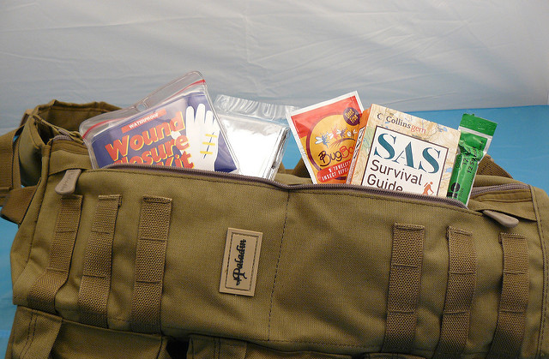
Physical security
Recommendations
Have a “go” bag with important personal and business documents in case of evacuation
Cost/benefits analysis for alarm system for doors and windows
This Photo by Unknown Author is licensed under CC BY-NC-ND

Slide 4

Website
Findings
http:// connection
Contact form is the same http:// connection
Privacy notice is basic
Website built and maintained by external company
This Photo by Unknown Author is licensed under CC BY

Slide 5

Website
Recommendations
Get a https:// connection
Get a NDA and a SLA for website designer
This Photo by Unknown Author is licensed under CC BY-SA

Slide 6

Information Technology: Equipment and connectivity
Findings
Personal Laptop
Laptop not secured with locking cable
Windows 10 Home
OS updates automatically accepted
Internet connection-Xfinity Xfi
Norton Security Suite
Business files not encrypted in storage
Basic policies, plans, and procedures are needed for continuity and demonstration of due diligence
This Photo by Unknown Author is licensed under CC BY-SA

Slide 7

Information technology: Equipment and connectivity
Recommendations
Separate business computer
Windows 10 Pro w/ Bit locker
Separate Wi-Fi router
Secured Wi-Fi connection
VPN secure connection
Secure laptop with locking cable
Finish policies, plans, and procedures
This Photo by Unknown Author is licensed under CC BY-ND

Slide 8

Backup Strategy
Findings
Personal Microsoft One Drive
School Microsoft One Drive
Google Drive
External 650 GB hard drive
This Photo by Unknown Author is licensed under CC BY-SA

Slide 9

Backup Strategy
Recommendations
Cloud storage on Microsoft One Drive for Business
Move and delete files from Google Drive
Develop backup policy on what is backed up
Develop backup procedures to ensure done correctly and according to schedule
This Photo by Unknown Author is licensed under CC BY-NC-ND

Slide 10

Applications used
Findings
QuickBooks Online
Gmail, Google Drive, Google Calendar, Chrome
Look Out Security Free (Android devices)
Norton Security Suite
IDShield Vault
Facebook
Microsoft One Drive (Personal & School)
Windows 10 Home
This Photo by Unknown Author is licensed under CC BY-NC-ND

Slide 11

Applications Used
Recommendations
GET MORE SECURE APPLICATIONS!!
This Photo by Unknown Author is licensed under CC BY

Slide 12
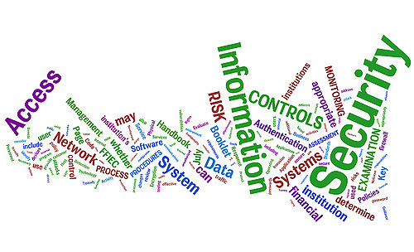
Risk value basis
Physical Security- Low threat and Moderate impact
Overall physical and environmental risk is Low
IT Risk- Moderate threat and Moderate impact
Current Risk- Moderate
Projected Risk- Low
Overall Risk
Current- Moderate
Projected Risk- Low
This Photo by Unknown Author is licensed under CC BY

